Slide 1

Listening to People (Part 2)
Training for Primary Care Contractors

Slide 2
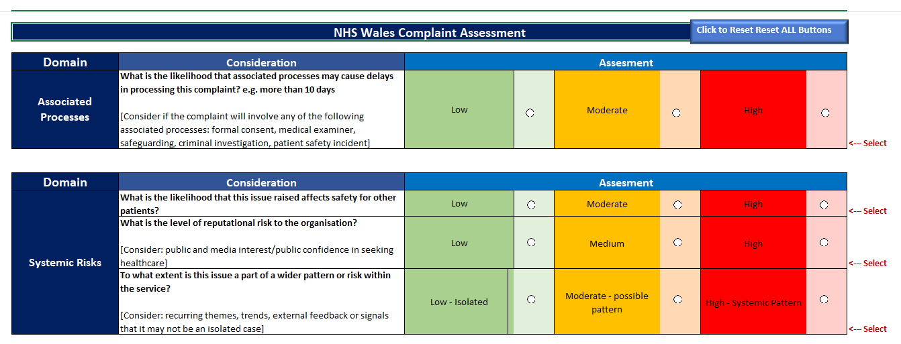


Slide 3
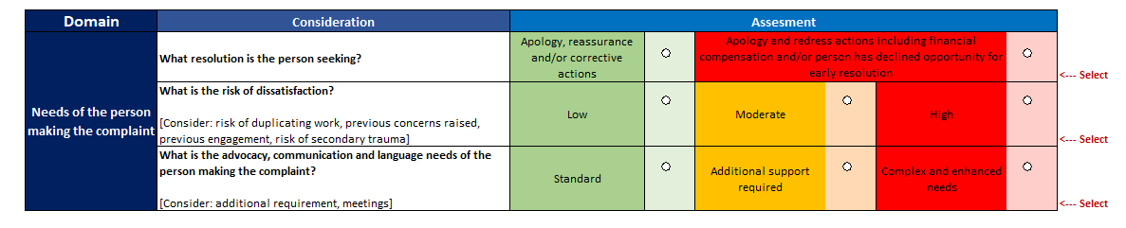
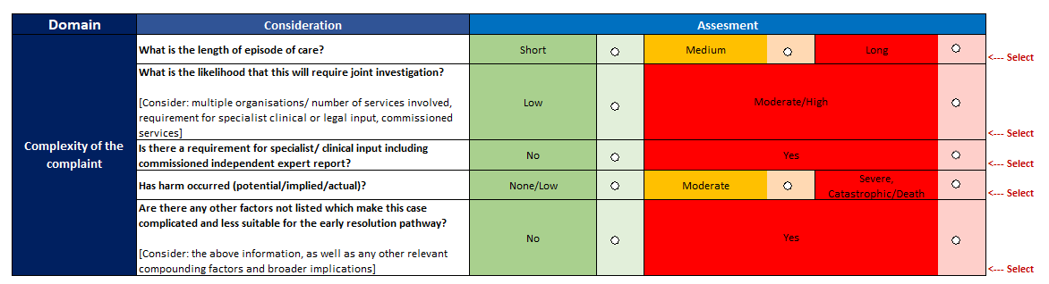

Slide 4
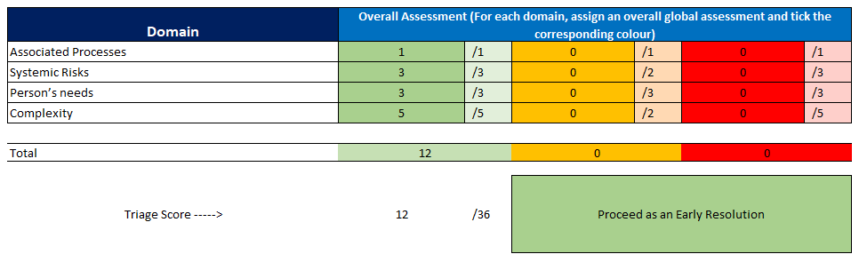

Slide 5
Determining the Appropriate Stage
Stage 1 (Early Resolutions) | Stage 2 (Formal Investigation) | Exceptional Circumstances
Appropriate when: Low/no harm (typically Grade 1). Straightforward issue. Resolution achievable within 10 working days. No safeguarding/criminal concerns. No need for formal investigation or redress. | Appropriate when: Moderate to severe harm (Grades 2–5). Complex, multi-factor concerns. Early resolution unsuitable or failed. Redress/compensation may be sought. Safeguarding/systemic issues present. | Appropriate when: Allegations of serious misconduct or poor care. Safeguarding concerns or abuse. Potential criminal investigation. Risk that provider investigation may be compromised.

Slide 6
Exceptional Circumstances
In rare and sensitive cases, it may be inappropriate for the concern to be raised directly with the Primary Care Provider or Independent Provider. These include situations involving:
  Allegations of serious misconduct or poor care.
  Safeguarding concerns or potential criminal matters.
  Risks that the provider-led investigation may compromise the integrity of the process.
In such cases, the concern should be notified directly to the LHB, which will:
  Offer a listening discussion to understand the concern.
  Decide within five working days who will lead the investigation in line with usual processes
  Inform the individual and the provider (unless contraindicated) of the decision.
Early resolution may still be possible if the LHB shares the concern with the primary care provider, as outlined in regulation 19.

Slide 7
Complaints received by BCUHB
BCUHB receives occasional complaints and queries relating to primary care contractors.
When queries or Stage 1 complaints are received, the complainant will be advised to contact the primary care contractor directly to raise their concerns.
When Stage 2 complaints are received, these will be reviewed to determine whether exceptional circumstances apply. The Health Board will then decide who is best placed to undertake the investigation in line with the relevant guidance and the primary care contractor will be informed accordingly.
As part of the assessment process, the Health Board may request relevant health records from the contractor.
Depending on the severity and nature of the complaint, the Health Board may arrange a listening discussion.
For complaints involving multiple services, decisions will be made on a case-by-case basis. This may result in either a joint investigation or the complaint being split, with the contractor responding to the elements relevant to their service.

Slide 8
Escalation to the Health Board
123. If the individual remains dissatisfied or early resolution is deemed inappropriate,
the provider must escalate the matter to the LHB, detailing all resolution attempts so
that the LHB can adequately determine whether or not it is appropriate for the
Primary Care Provider or the LHB to investigate the concern. If the Primary Care
Provider has issued a response in accordance with regulation 24 or the person does
not consent to the LHB investigating the concern, the LHB must not investigate. This
process is governed by Regulation 20.
We are liaising with other Health Boards and WG to determine the formal process for escalation.
In the interim period, if a contractor needs to escalate a complaint as above please contact the PCCG via email at BCU.PrimaryCareClinicalGovernance@wales.nhs.uk and await further guidance.

Slide 9
Harm Grading Framework
Grade | Examples of Concerns
Grade 1 – None | • Delay without clinical impact; fall with no injury; admin error corrected with no effect.
Grade 2 – Low | • Minor treatment delays. • Short increase in length of stay (1–3 days). • Minor injury requiring simple treatment.
Grade 3 – Moderate | • Avoidable injury requiring intervention. • Readmission or return to surgery. • Transfer to higher acuity resulting intervention to save life • RIDDOR reportable incident.
Grade 4 – Severe | • Permanent harm or disability or function loss: • Extended hospital stay (>15 days) with permanent sequalae • Significant breach of national standards.
Grade 5 - Death | • Avoidable death or care contributing; maternal/perinatal/infant death. • Gross failure to meet standards. • Irreversible health effects.

Slide 10
Acknowledging and Initiating Engagement
  Acknowledge the complaint in writing (max 5 working days).
  Offer a listening discussion (mandatory offer; phone/video/face-to-face).
  Identify key needs and preferences:
      Communication method (e.g. Welsh language).
      Accessibility needs.
      Advocacy requirements.
  Explain the process and options
      Stage 1 (early resolution).
      Stage 2 (formal investigation).
      Redress (if applicable later).

