Slide 1

Listening to People (Part 3)
Training for Primary Care Contractors

Slide 2

Acknowledgement letter suggestions:
Confirmation of receipt and apology that individual has felt that they need to raise a concern.
Provision of a key point of contact with contact details.
Offer of a listening discussion (within 5 days) .
Explanation of process e.g. Stage 1, Stage 2.
Timescales; if known.
Duty of Candour – make individual aware that they may be contacted if harm is identified.
Confidentiality – ensure individual is aware that their records will be accessed and outline process to request records if individual would like a copy.
Consent – advise individual that consent and evidence is required when appropriate
Make individual aware of advocacy service – Llais.
Accessibility needs (e.g. Welsh language, hearing/sight needs).

Slide 3
Listening Discussion
The listening discussion aims to fully understand the nature and details of the concern. It provides an opportunity for the individual to clearly express their concerns, whether related to a complaint or an incident in care.
This discussion is crucial for understanding the nature and details of the concern and is designed to ensure that the individual feels heard and respected.
Key points:
Clarify desired outcomes and manage expectations.
Demonstrate compassion and empathy.
Apply active listening techniques.
Offer Timing: The listening discussion must be offered within 5 working days of acknowledging the concern.
Ensure a record of the listening discussion is kept.
E-learning training:
Tier 1 Training for Listening Discussions English Slides - English
Tier 1 Training for Listening Discussions English Slides - Welsh
LTP Training for Tier 1 Webinar - English
LTP Training for Tier 1 Webinar - Welsh
Following completion of the listening discussion – if held – it is important to review the initial triage and ensure the grading remains the same and that all key points are covered.

Slide 4
Timescales
Stage 1: Early Resolution complaints – Grade 1 (10 working days from the date of acknowledgment).
Stage 2: Formal complaints – Grade 2 – 5 (A timeframe of 30, 60, 90, 120, 127* working days will be allocated based on Triage, from the date received ) * 127 days is 6 months in working days.
Basic example
May 1st – complaint received.
May 5th – complaint acknowledged – Stage 1.
May 5th – 15th – Stage 1 attempted (10 days) and fails.
The complaint clock reverts to complaint received date (in this case May 1st) and you have already taken 15 days, so we only now have 15 days to provide a response under stage 2.
Therefore, it is important to consider this when determining whether a complaint should be handled via Stage 1 or Stage 2.

Slide 5
Investigation
Plan | What happened? What should have happened? What are we investigating? Who’s involved? What evidence is required?
Evidence collection | Clinical records. Appointment/communication logs. Relevant policies/guidelines. Obtain staff statements (factual, chronological). Seek clinical/independent advice if required. Compile a clear timeline of events.
Review | Compare care against clinical standards and local/national guidance. Care delivered vs expected care. Any gaps or failures?
Findings | Conclude (per issue). Provide clear rationale and evidence-based explanation.
Actions & Learning | Identify improvements. Develop action plan.

Slide 6
Response
Should include:
  Acknowledgement.
  Summary of issues raised.
  Explanation of investigation undertaken.
  Clear findings (per issue).
      What happened.
      What should have happened.
      What you found (decision).
      Why (clear rationale).
  An apology (where appropriate).
  Actions taken / Learning.
  Outcome summary.
  Offer of further discussion.
  Information on escalation (PSOW).

Slide 7
Example flow charts
Flow Chart 1 – Stage 1 (Early Resolution)
Flow Chart 2 – Stage 2 (Formal Investigation)

Slide 8
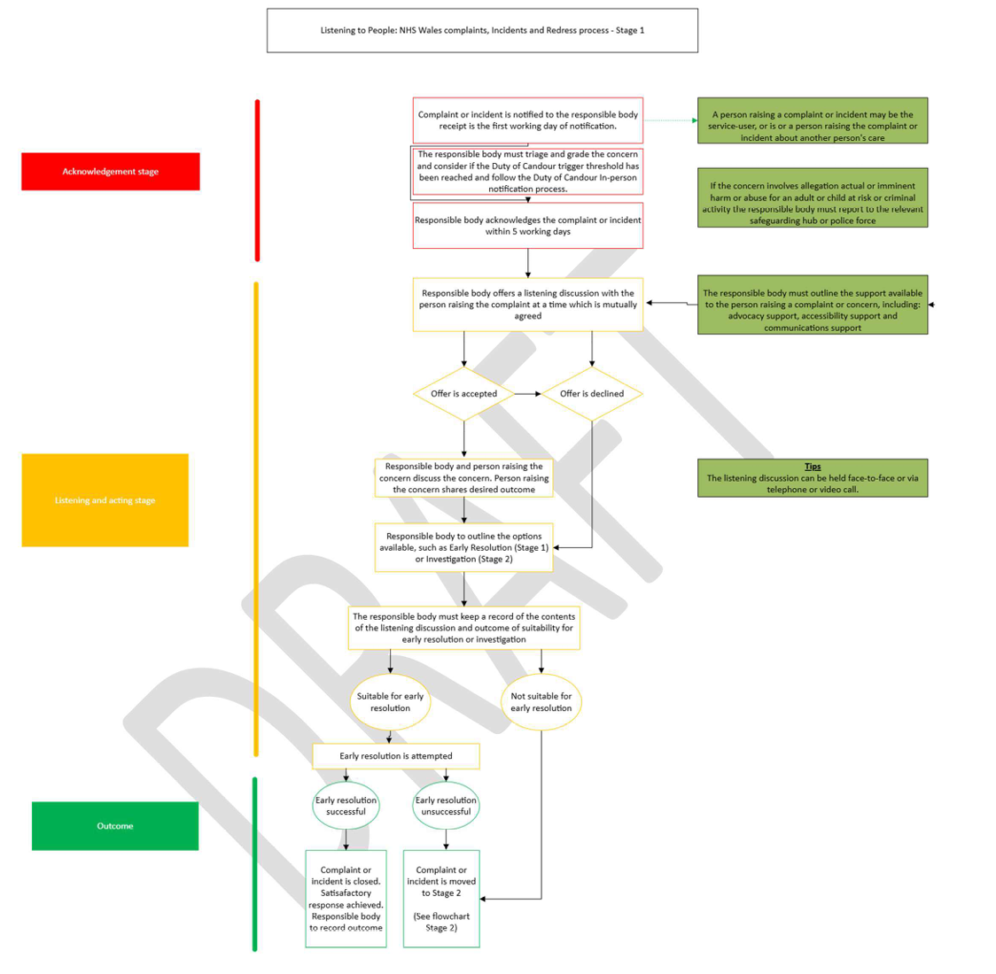

Slide 9
